Slide 1

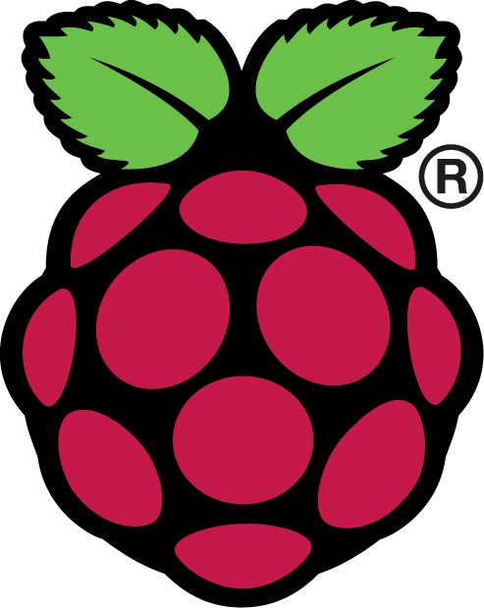
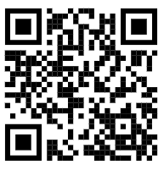
Simple demo
Raspberry Pi +
Azure IoT Central +
Ultrasonic sensor

Slide 2
Before getting started, you need to…..
➔ Have a Raspberry Pi
➔ Know some basic of Raspberry Pi
Install Raspbian
Remote control Raspberry Pi
Update Raspberry Pi
Know the GPIO pin of RSP
➔ Know basic of Python
*The summarise steps for setting up the RSP is provided in the end of the slide

Slide 3
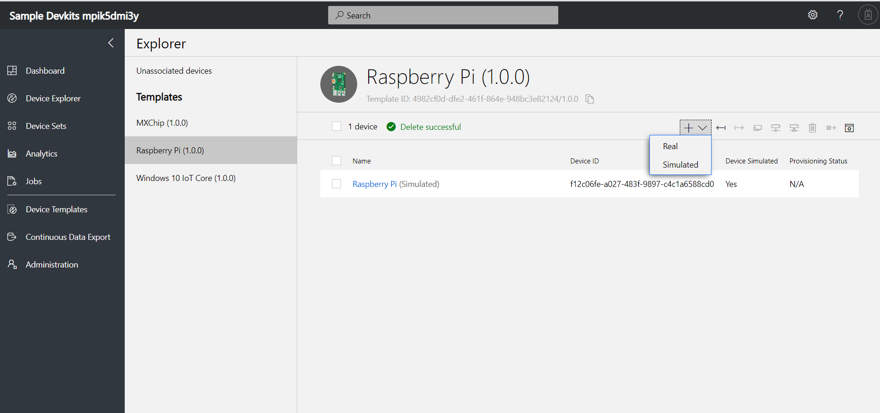
1. Create a Real device in your dashboard
azureiotcentral.com

Slide 4
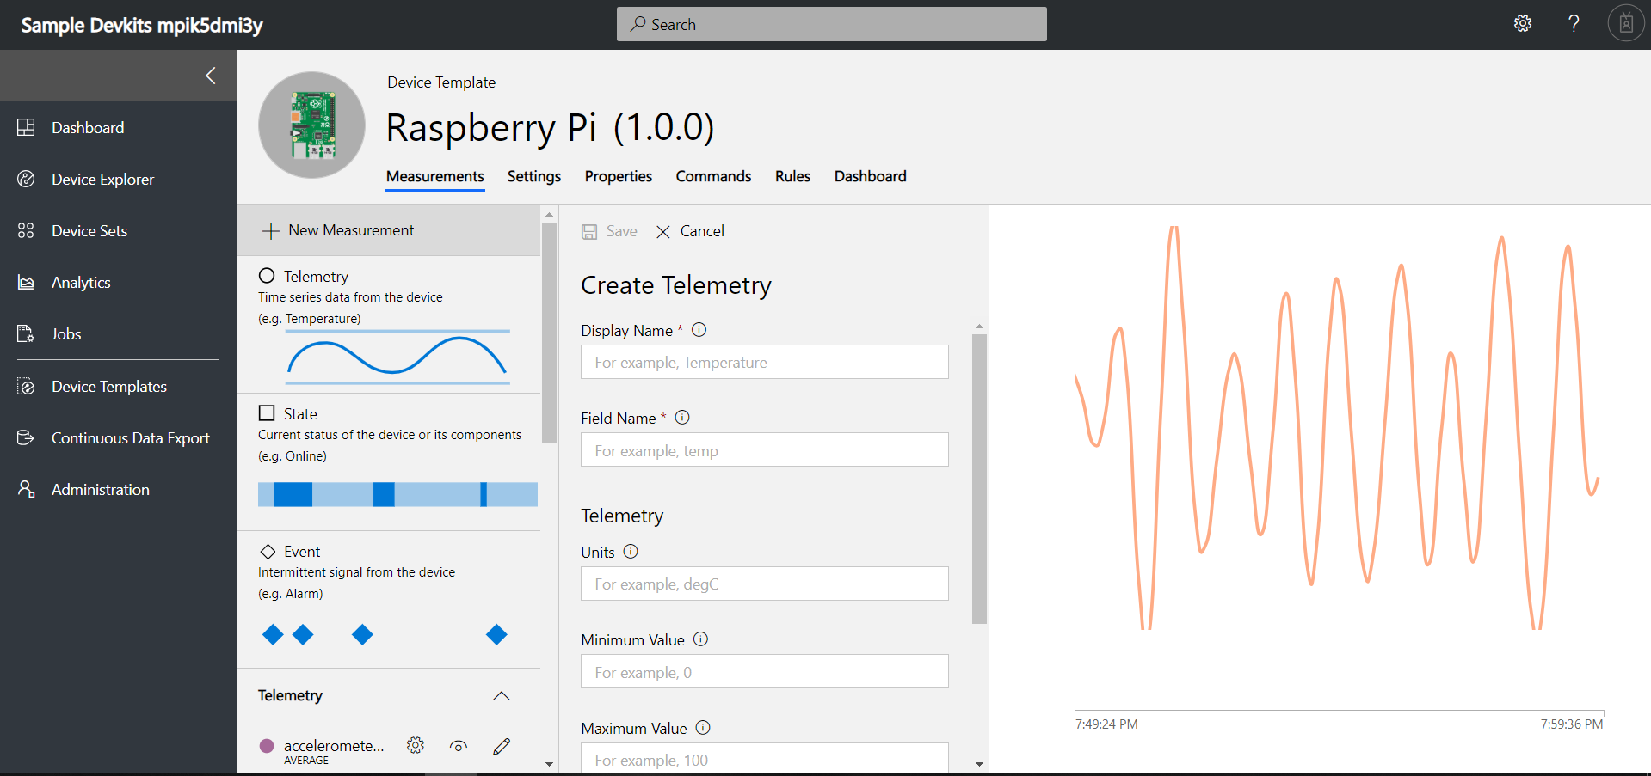
2. Create your own telemetry
e.g. ultrasonic

Slide 5
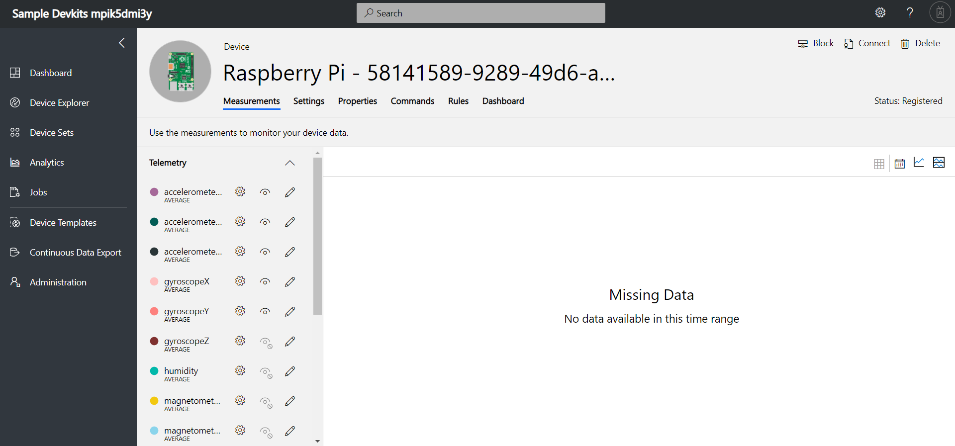
3. Go back to the device created and click connect

Slide 6
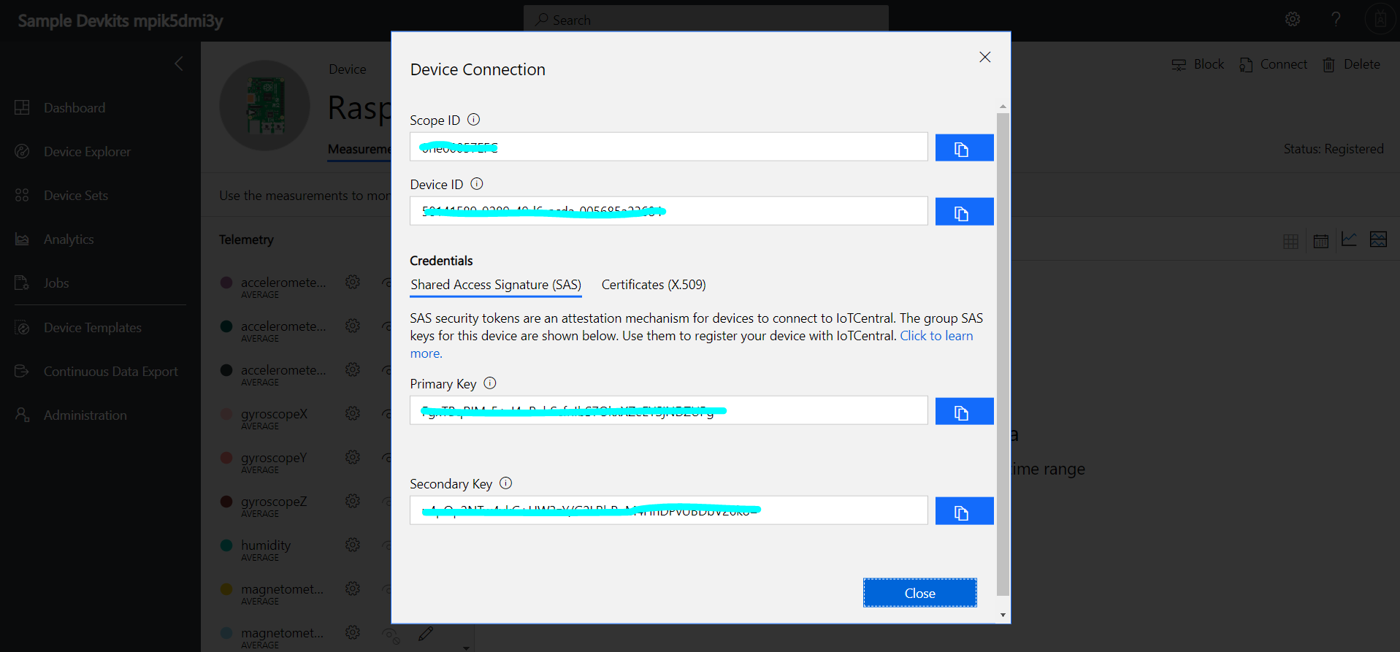
4. Copy the credentials

Slide 7
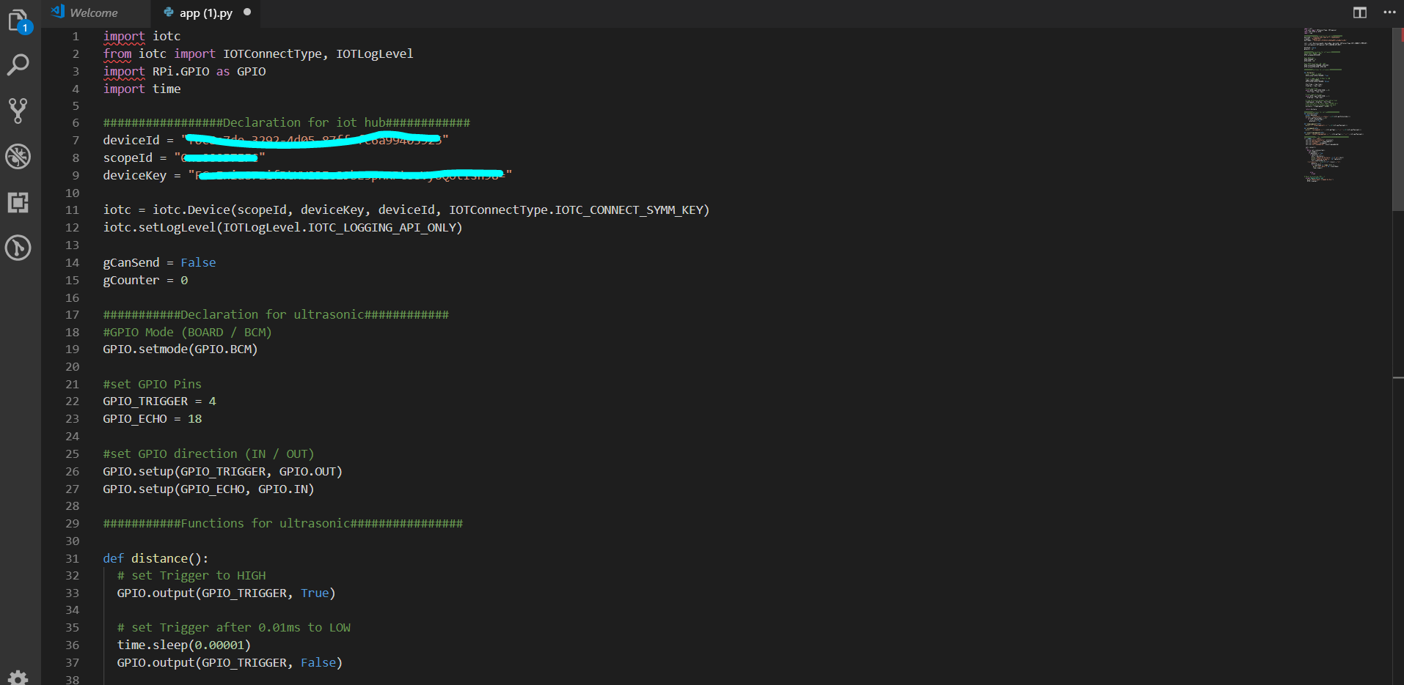
5. Paste your credential to the code provided

Slide 8
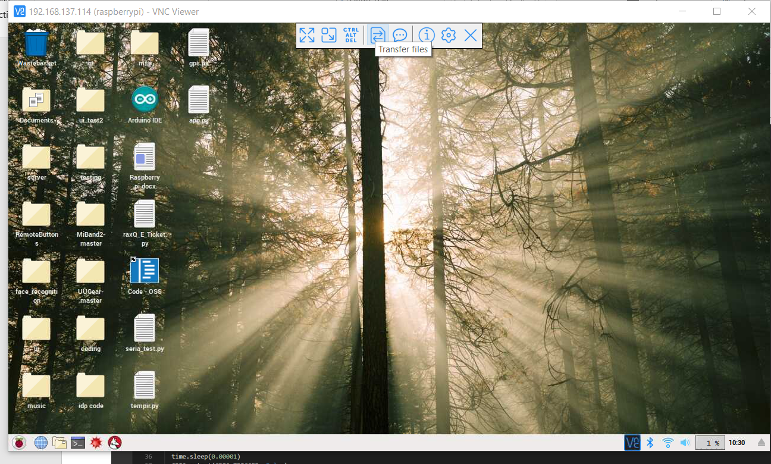
6. Transfer the code to your Raspberry Pi

Slide 9
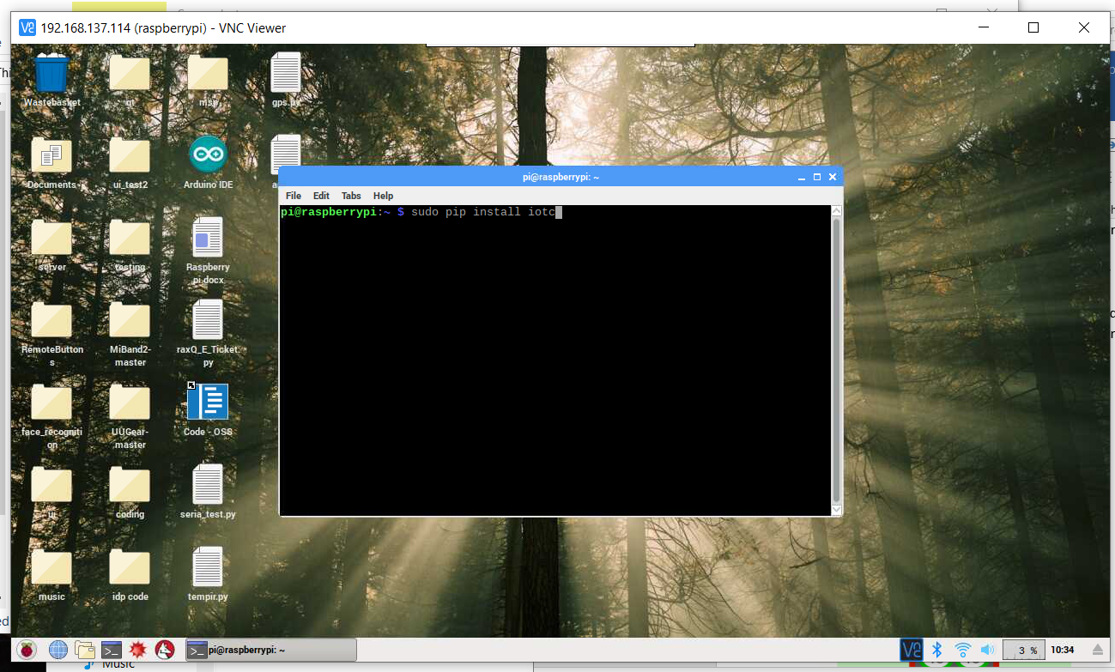
7. “Sudo pip install” libraries needed
sudo pip3 install iotc
sudo pip3 install time

Slide 10
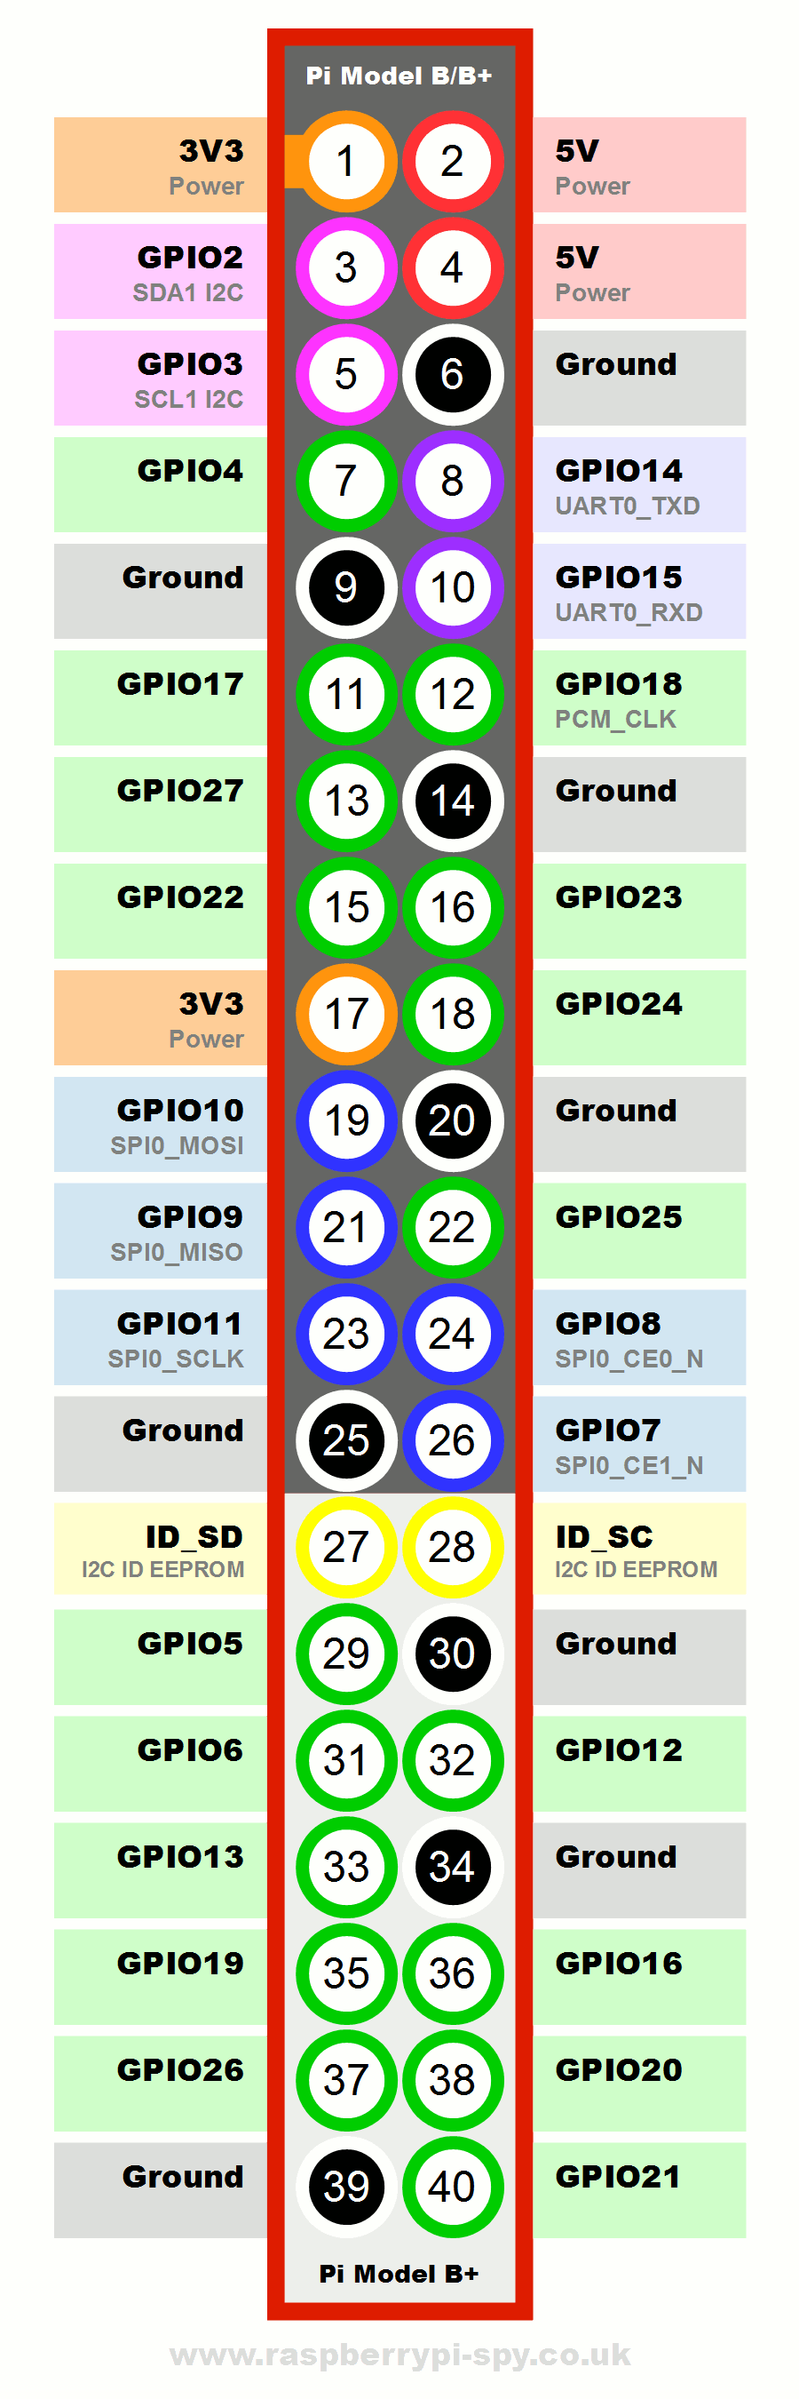
7. Plug in your ultrasonic sensor!
VCC = 5V
Ground = Ground
Trigger = GPIO 4
Echo = GPIO 18
*It all depends on how you declare it

Slide 11
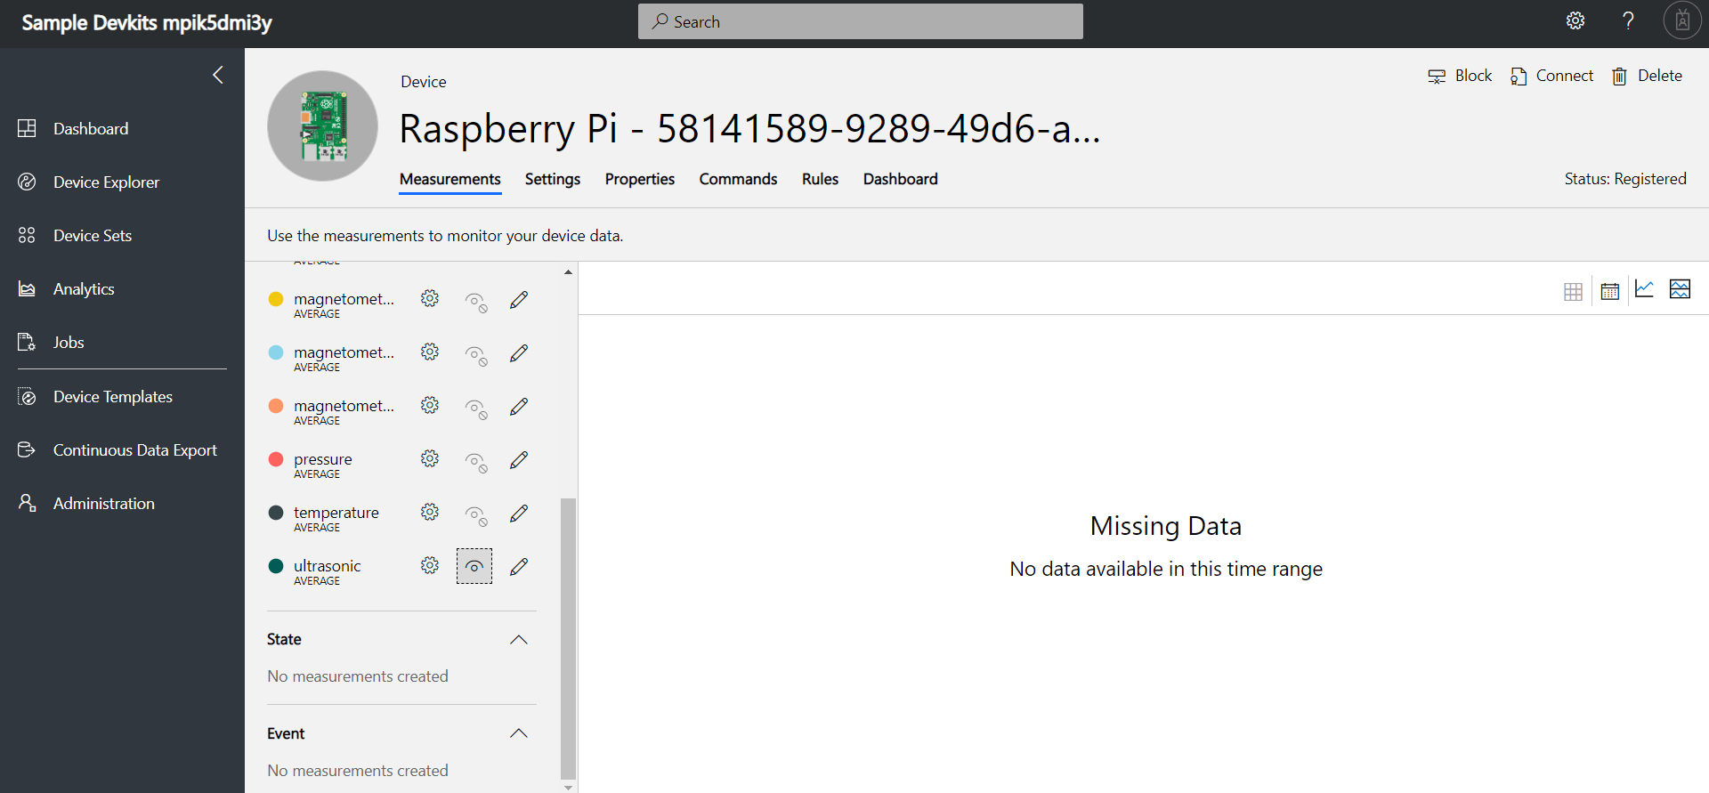
7. Make sure your telemetry is visible

Slide 12
7. Run your code in the Raspberry Pi and see the results!

Slide 13
Appendix

Slide 14
Basic of Raspberry Pi
Install Raspbian OS
SD card formater to format the SD card
Use win32DiskImager to install the Raspbian OS you have downloaded at the official website
Remote control Raspberry pi
Connect to monitor and open setting to enable SSH and VNC
Create a hotspot and let your raspberry pi connect to it
Download VNC viewer in your laptop
Copy the IP address of your raspberry pi (192.168.43.???)
Type in your IP address
Default user name is ‘pi’ and password is ‘raspberry’
Connect your pi, so now you can control your pi without keyboard and mouse
Update raspberry pi
Sudo apt-get update
Sudo apt-get upgrade
GPIO pin

